Slide 1
Using PHP With Cookies and MySQL
Chapter 12

Slide 2

12.1
Cookies

Slide 3
Types of Cookies
a cookie is a little text file that resides on the user's computer
is placed there by the browser when the browser receives some information from the website's server.
cookies have no evil intent; their main purpose is to identify users and possibly prepare some customizations on a web page when the user revisits the site
cookies cannot carry viruses and cannot install malware on a user's computer
authentication cookies allow a web server to know whether a user is logged in and which account the user is logged in under. Without such information, the site would not know whether or not to send sensitive information (such as logging in to a bank’s website)
a session cookie exists only while a user is on a particular website
is normally deleted by the browser when the user exits the browser
a persistent cookie remains on the user's computer for a specified length of time, even after the user has left the site, exited the browser, and turned off the computer
a secure cookie has the secure attribute enabled and is only used via HTTPS
ensures that the cookie will be encrypted when transmitting from client to server
a httponly cookie is supported by most modern browsers and is used when transmitting HTTP or HTTPS requests
feature only applies to session cookies
A third-party cookie is set with a different domain from the one that shows in the address bar of the browser
often set by advertisers to gain information about what website a user has visited

Slide 4
Writing Cookies
the setcookie() function defines a cookie
must be called before any output, including the <html> and <head> tags
after a cookie has been set, it can be accessed the next time the page loads using the $_COOKIE superglobal or $_REQUEST
setcookie() function accepts up to six arguments, all but $name are optional
general syntax for this function:
bool setcookie(string $name [, string $value [, int $expire = 0 [, string $path [, string $domain [, bool $secure = false [, bool $httponly = false ]]]]]] )
explanation of the parameters in this function:
$name: the name of the cookie
$value: the value stored on the client's computer, will be retrieved by the server
$expire: sets the expiration date of the cookie
time is expressed in number of seconds since a specific date/hour/minute/seconds
$path: the path on the server in which the cookie will be available
$domain: the domain to which the cookie is available
$secure: a boolean, set to either true or false
$httponly: a boolean, is accessible only through the HTTP protocol when set to true and, if true, the cookie will not be accessible to other scripting languages like JavaScript

Slide 5
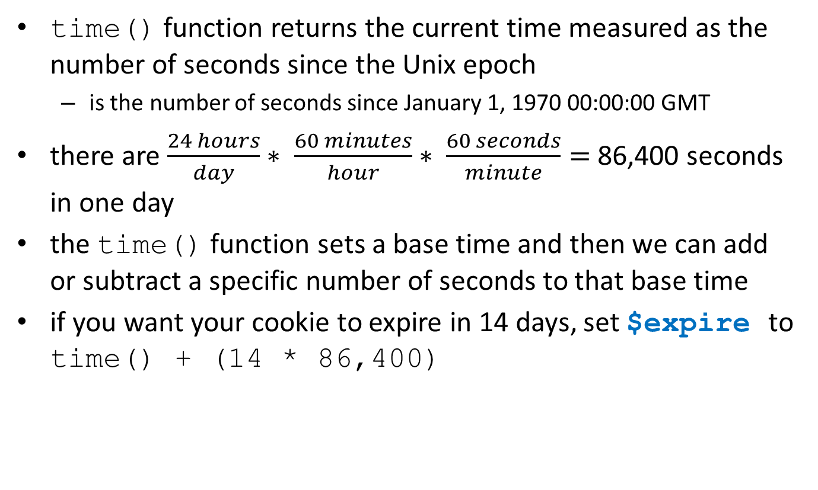
The time() Function
time() function returns the current time measured as the number of seconds since the Unix epoch
is the number of seconds since January 1, 1970 00:00:00 GMT
there are $\frac{24 hours}{day}∗ \frac{60 minutes}{hour}∗ \frac{60 seconds}{minute}=$ 86,400 seconds in one day
the time() function sets a base time and then we can add or subtract a specific number of seconds to that base time
if you want your cookie to expire in 14 days, set $expire to time() + (14 * 86,400)

Slide 6
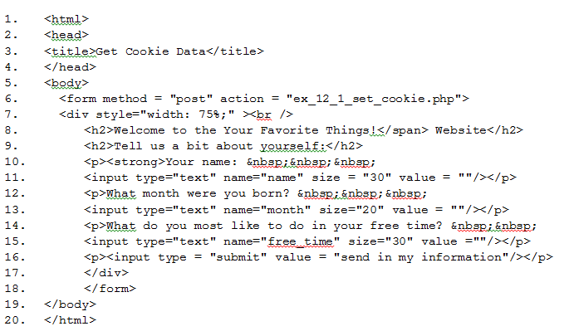
Writing a Cookie: get the information

Slide 7
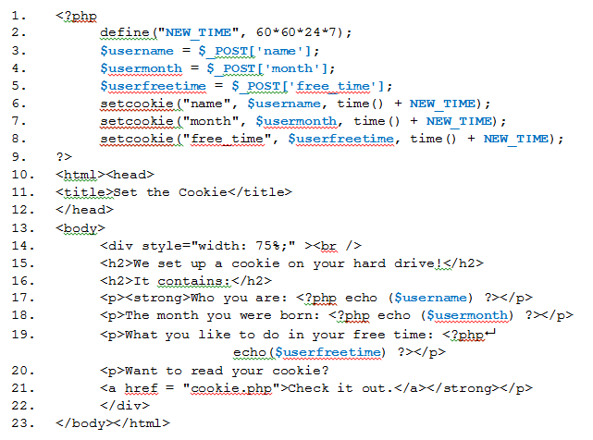
Setting the Cookie: it includes PHP so filename must have .php extension

Slide 8
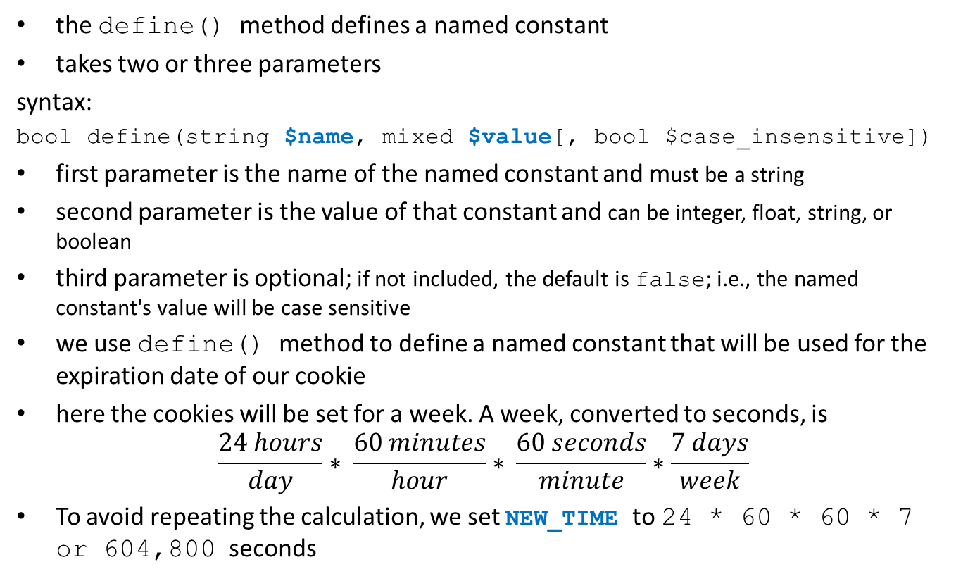
Explanation: the define() Method
the define() method defines a named constant
takes two or three parameters
syntax:
bool define(string $name, mixed $value[, bool $case_insensitive])
first parameter is the name of the named constant and must be a string
second parameter is the value of that constant and can be integer, float, string, or boolean
third parameter is optional; if not included, the default is false; i.e., the named constant's value will be case sensitive
we use define() method to define a named constant that will be used for the expiration date of our cookie
here the cookies will be set for a week. A week, converted to seconds, is
$$\frac{24 hours}{day}∗ \frac{60 minutes}{hour}∗ \frac{60 seconds}{minute}∗\frac{7 days}{week}$$
To avoid repeating the calculation, we set NEW_TIME to 24 * 60 * 60 * 7 or 604,800 seconds

Slide 9
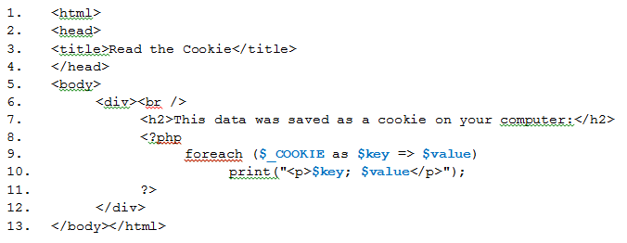
Reading Your First Cookie

Slide 10
The isset() Method
the isset() method is a convenient way to check if a value has been given to a variable
the method is a boolean
if the argument in the parentheses has been set and is not NULL, isset() will return true
otherwise, it will return false
syntax:
bool isset($var);
if $var has a value, this statement returns true but if $var has not been assigned a value, the statement returns false

Slide 11
The $_SERVER() Method and PHP_SELF
$_SERVER is a superglobal
is an array which contains different types of information such as headers, paths, and script locations
PHP_SELF is one of the possible indices of $_SERVER
is the filename of the script that is currently executing, relative to the document root
if we assume our file has the filename hello.php and is in a folder named my_php_pages in htdocs, $_SERVER('PHP_SELF') is:
/my_php_pages/hello.php

Slide 12
12.2
A Database Server: MySQL

Slide 13
Overview of MySQL
MySQL is a popular open source relational database management system (RDBMS)
was founded by Michael Widenius
pronounce MySQL as "my sequel"
SQL stands for Structured Query Language
MySQL is now owned by the Oracle Corporation

Slide 14
Benefits of MySQL
implementations of MySQL for many operating system platforms
can handle large databases that may include tens of thousands of tables with millions of rows
is scalable
can be embedded in an application
can be used in an enormous data warehouse environment
supports many programming languages
can be accessed regardless of the programming language that wants to use it
offers comprehensive support for application development needs
offers many security features for data protection
includes many self-management features

Slide 15
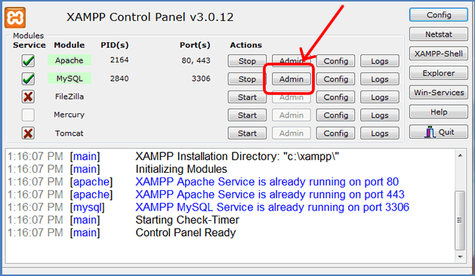
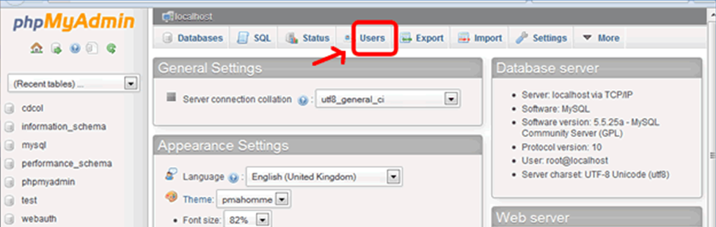
Setting Up a MySQL User Account
To access phpMyAdmin, click the Admin button from the MySQL option in the XAMPP Control Panel:
use the Users tab to create a new user:

Slide 16
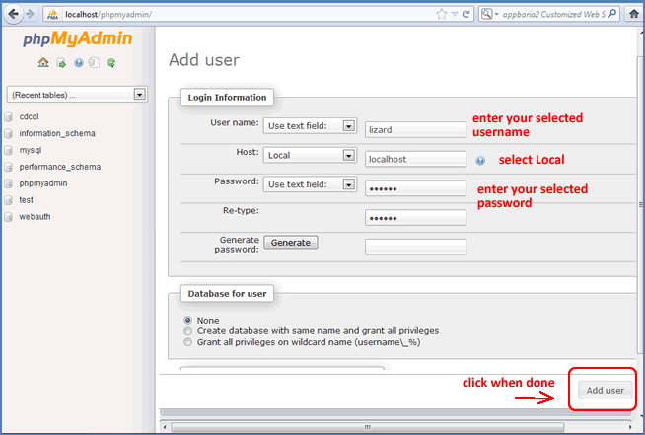
Create a New User
Click the Users tab. Then click the Add user link in the middle of the screen. Enter the username you want to use and the password (enter and retype) you want to use but select Local for the Host.

Slide 17
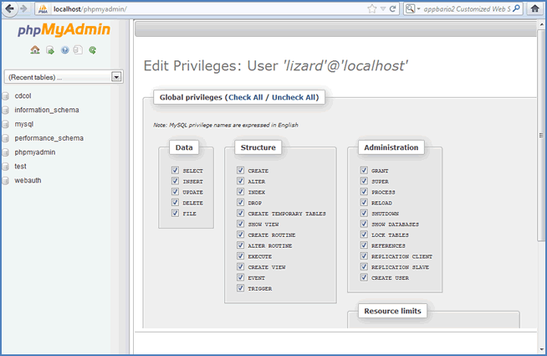
Assigning Privileges
Select your newly created user and click the Edit Privileges link. To give the new user Global privileges select Check All at the next screen. Tip: If this screen is partially hidden, put your cursor in the top-left corner of the Edit Privileges window and, when the four-way arrow appears, move the mouse quickly to the left.

Slide 18
The Database Structure: Using an example to build a database for a small business
a database for Jackie's Jewelry site
Jackie needs to keep track of her customers (who buys her stuff?), her stock (does she have enough inventory?), and her orders (who is buying what?).
Jackie's Tables
Our database will contain three tables, each with data that will help Jackie answer the questions posed above:
customers
products
orders
Each customer in the customers table is a record. Each product in the products table and each order placed in the orders table is also a record.

Slide 19
Primary and Foreign Keys
The primary key of each table in a relational database is the unique identifier for each record.
should always be something that no other record will have
for example, two customers may have the same name or two people may place an identical order; therefore, neither the customer's name nor the order description is an appropriate primary key
but, if each customer is assigned a unique ID number, there is no chance that two customers will have that same number
if each order has an invoice number, there is no chance that two orders will have the same invoice number
colleges issue student ID numbers to avoid the possibility that information about one student will get mixed up with another student
Every database table must have one column designated as the primary key.
A foreign key is a field that matches the primary key column of another table.
for example, if we wanted to know if customer Janet Johansen ordered a jade necklace, we would match the ID number assigned to customer Janet Johansen with the product key for jade necklaces

Slide 20
Table Fields in Jackie’s Database
customer table fields:
customerID—the primary key because it is unique to each customer
customerName—the full name of a customer
customerEmail—how an order confirmation will be sent or other promotional ads can be distributed
other fields might be included, such as a shipping address or preferred payment method
orders table fields:
orderInvoice—the primary key because it is unique to each order
orderCustomer—the name of the customer who placed the order
orderProduct—the product that was ordered
orderQuantity—how many items were ordered by the customer
products table fields:
productID—the primary key because it is unique to each product
productName—the description of each item Jackie sells
productQuantity—the number of each item Jackie has in stock

Slide 21
Field Attributes: the ones of interest to us
Name: the name given to a field
for example, we name the ID of the customers in the customer table customerID and the email address field customerEmail
the name you assign each table and each field is up to you but should be consistent
Type: the data type of the information in a field
a quantity would be an INT but a name would be text
use VARCHAR because it saves space when the database is stored
Length/Values: allocates the number of spaces needed for a field
for example, can allocate 25 spaces for a name but only 5 or 6 for an integer
five spaces allows for an integer of, maximum, 99,999
Attributes: allows us to set the type of numeric value in a numeric field
when the numbers are integers, set this to UNSIGNED or UNSIGNED ZEROFILL
A_I: stands for auto_increment
is used for fields like IDs
each time a new record is added, this feature automatically increments the new customer's ID
check this box for the three primary keys (customerID, productID, and orderInvoice)

Slide 22
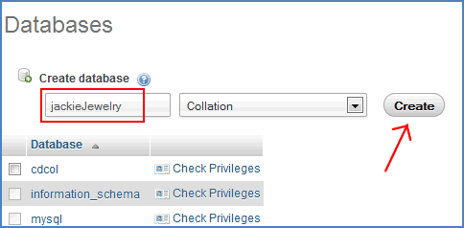
Creating the Database for Jackie
From the Home screen in phpMyAdmin, click the Databases tab. Type the database name into the box under Create database. Name the database jackiejewelry. Then click the Create button.

Slide 23
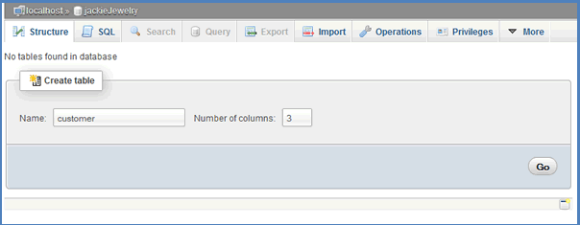
Creating the Database for Jackie
When you click the jackiejewelry database you will see a screen that says no tables are found. We will create three tables. The first table, customer, will have three fields so we will enter the table name, customer, and a 3 in the Number of columns box. Then click the Go button.

Slide 24
Table Field Structure for the customers Table of the jackiejewelry Database
Structure for customers Table
Name | Type | Length/Values | Default | Collation | Attributes
customerID | INT | 6 | NONE |  | unsigned
customerName | VARCHAR | 20 | NONE
customerEmail | VARCHAR | 40 | NONE
(Structure continued)
Null | Index | A_I | MIME type | Browser Transformation | Browser Options
 | PRIMARY | ✓

Slide 25
Table Field Structure for the orders Table of the jackiejewelry Database
Structure for orders Table
Name | Type | Length/Values | Default | Collation | Attributes
orderInvoice | INT | 6 | NONE |  | unsigned
orderCustomer | VARCHAR | 20 | NONE
orderProduct | VARCHAR | 30 | NONE
orderQuantity | INT | 4 | NONE |  | unsigned
(Structure continued)
Null | Index | A_I | MIME type | Browser Transformation | Browser Options
 | PRIMARY | ✓

Slide 26
Table Field Structure for the products Table of the jackiejewelry Database
Structure for products Table
Name | Type | Length/Values | Default |  | Collation | Attributes
productID | INT | 6 | NONE |  |  | unsigned
productName | VARCHAR | 30 | NONE
productQuantity | INT | 3 | NONE |  |  | unsigned
(Structure continued)
Null | Index | A_I | MIME type | Browser Transformation |  | Browser Options
 | PRIMARY | ✓

Slide 27
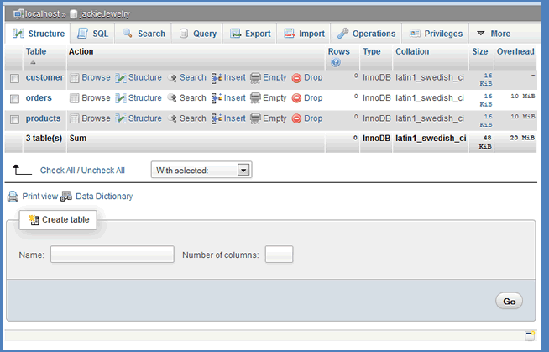
The jackiejewelry Database in XAMPP

Slide 28
12.3
Populating a Database from the Web

Slide 29
Adding Records to the Database
many ways to populate a database but, since we are programming for the web, the most appropriate format is to create a web form where information entered by a user will become a record in the proper table in the database
requires several PHP files and a folder structure as shown, using Jackie’s business as an example:
the images and the style sheet (jackie.css) files are available in the Student Data Files.
jackie
assets
css (put jackie.css in this folder)
images (put any images in this folder)
include

Slide 30
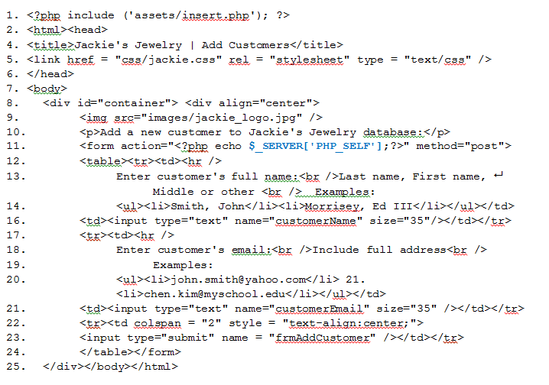
The main page is named index.php and should be stored in the jackie folder but not in any subfolder. The code here is truncated to save space:

Slide 31
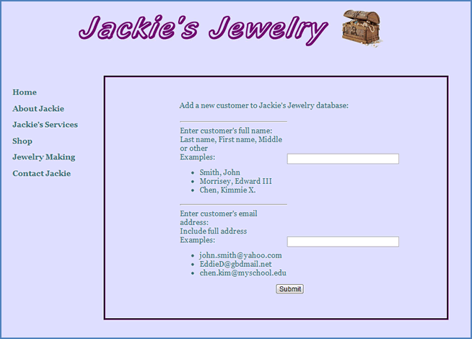
Result of code, including navigation and styles

Slide 32
The die()and mysql_error() Methods
the die() function is a PHP function that can be used as an alternate to the exit() function
is normally used when trying to connect to a database or website and includes a message that will be displayed if the connection is unable to be made
syntax: die(message);
the mysql_error() method returns the error description of a MySQL operation that cannot be completed
if there is no error, then the empty string ("") is returned
otherwise, the error message will correspond to whatever error has occurred
example: if the user does not have access to the required database, the error could be "Access denied for user 'whoever'@'whatever_host'“
this method is often used in conjunction with the die() method so if a connection is not possible, the program will stop and the appropriate error will be generated
syntax: die(mysql_error());

Slide 33
The mysql_query()Method
The mysql_query() method executes a query on a MySQL database.
The method takes two arguments—the actual query and the connection.
The connection argument is optional. If omitted, the last connection opened will be used.
A query is the way we retrieve or import information from and to a database.
syntax: mysql_query(query, connection);

Slide 34
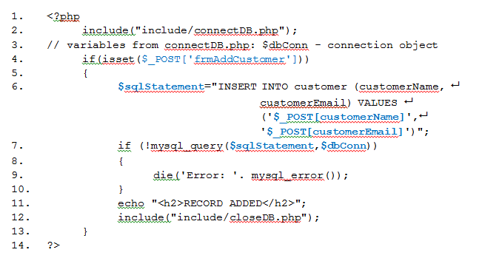
This page begins a connection to the database and sends in the information from the index.php page to be inserted as a new record in the database.

Slide 35
The mysql_connect() Method
the mysql_connect() PHP method opens a connection to a MySQL database
if successful, it returns the connection
if unsuccessful, it returns false
takes up to five (all optional) parameters, as follows:
server: can specify a server or a port
default value is localhost:3306
user: can specify a username
default value is the name of the user who owns the server process
pwd: if left blank, the default is ""
newlink: a way to return the identifier of an already-opened connection
clientflag: can be used to specify certain constants (not necessary for us)
syntax:
mysql_connect(server, user, pwd, newlink, clientflag);

Slide 36
The mysql_select_db() Method
this method picks the database to use
sets the MySQL database that will be active for the connection
takes two parameters:
database: This is required and specifies the database to select
connection: This is optional and, if not specified, will use the last connection opened by mysql_connect()
syntax:
mysql_select_db(database, connection);

Slide 37
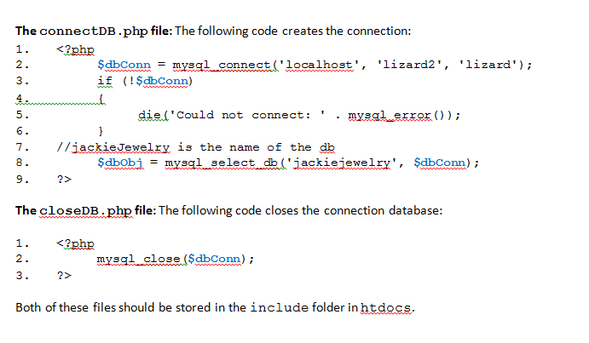
Creating and Closing a Connection to the Database

Slide 38
12.4
Sending Emails from Database Information Using PHP

Slide 39
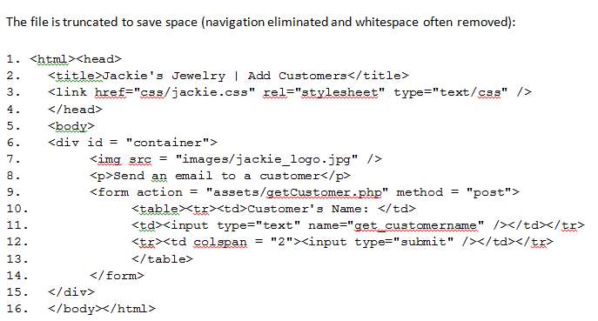
The form that allows Jackie to select a customer to send an email to is shown below. The file is named sale_email.php and is saved in the jackie folder inside htdocs. It uses the connectDB.php and closeDB.php files and a new page to get the customer's record, format the email, and send it.

Slide 40
The mysql_fetch_array() Method
the mysql_fetch_array() method returns an array of strings that corresponds to the fetched row
if there are no more rows, the return will be false
it takes one argument: the result which is the resource that is being evaluated
a resource is a special variable that holds a reference to an external source, such as the result of a SQL query
syntax:
mysql_fetch_array(resource $result[,$result_type_if_desired]);

Slide 41
The mail() Method
the mail() method is used to send email with PHP
contains at least three parameters
others can be added if desired
$to: includes email address(es) of the recipient(s)
more than one recipient can be included, separating addresses by commas
$subject: includes text to be included in the subject line
$message: contains the body of the email
each line in the body should be separated by a linefeed (LF) which is written "\n“
no line can be greater than 70 characters
$headers: includes the sender of the email
is a string that will be inserted at the end of the email header
additional headers and additional parameters are available and optional
syntax: mail mail($to,$subject,$message,$headers);

Slide 42
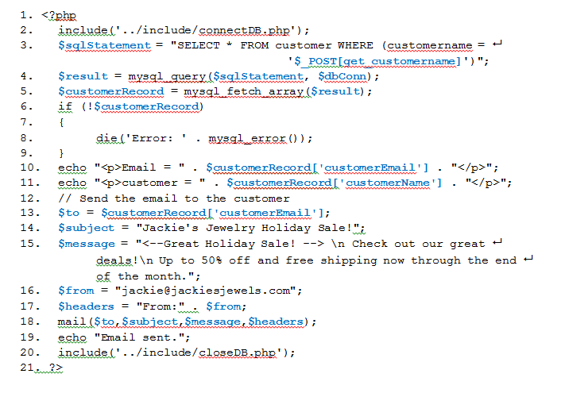
Using PHP to Create and Send an Email: Name this file sale_mail.php

Slide 43
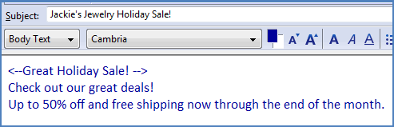
The result
If the connectDB.php file and the closeDB.php file were stored in the include folder and the sale_mail.php file was opened:
Input: a user named Nancy Peterson, email address: nancy.peterson@ourschool.edu
Jackie will receive a confirmation:
Email = nancy.peterson@ourschool.edu
customer = Peterson, Nancy
Email sent.
Nancy Peterson will receive this email:

